Slide 1
UI/UX Case study-Mobile Banking App Redesign
Day1-Project Setup and Research

Slide 2
Introduction
This is a unsolicited project that I did as a part of my Portfolio. My objective was to choose a banking app that has negative reviews on the Play Store and create a better interface for the same.

Slide 3
Goals
Improvement of the User interface and user experience
Improve the accessibility through research
Make the app more user friendly
Improve the app based on research and analysis

Slide 4
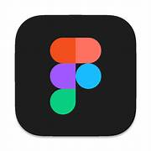
Tools
Figma

Slide 5
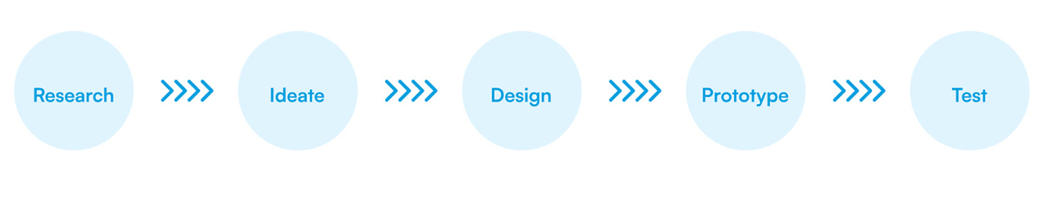
Project Plan

Slide 6
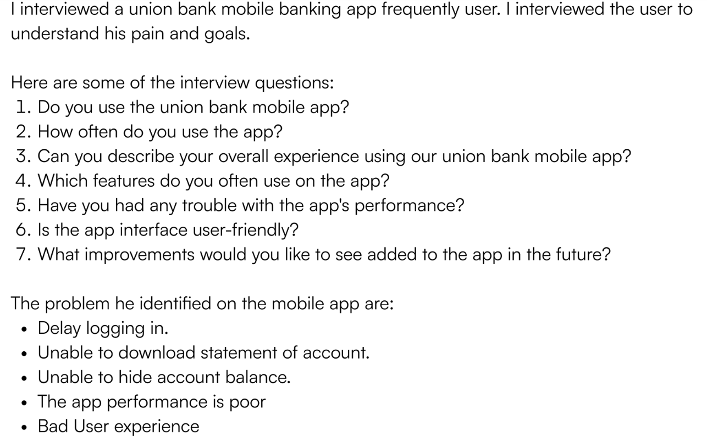
User research

Slide 7
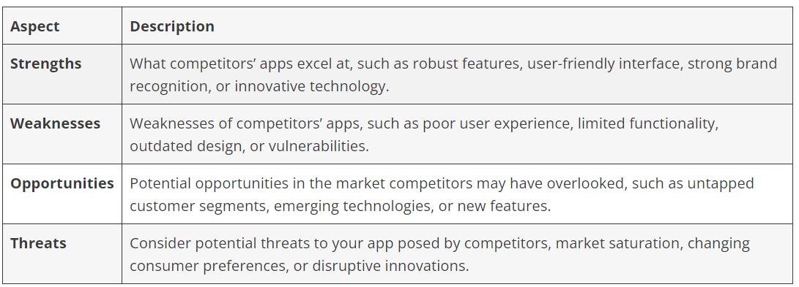
Competitors strength and weakness Competitior1

Slide 8
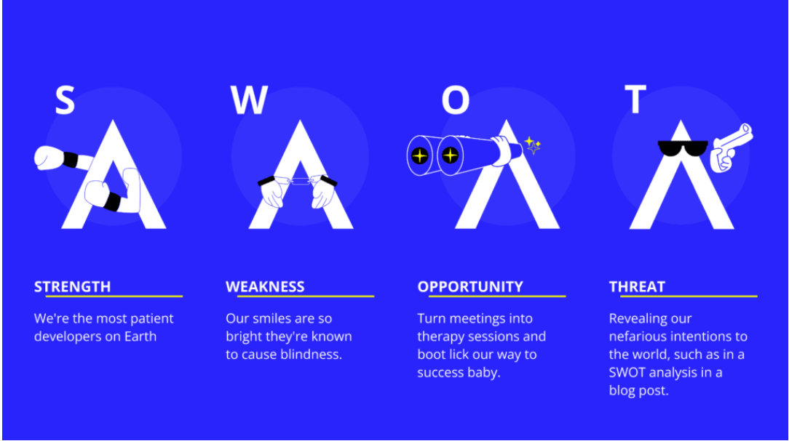
Competitior2

Slide 9
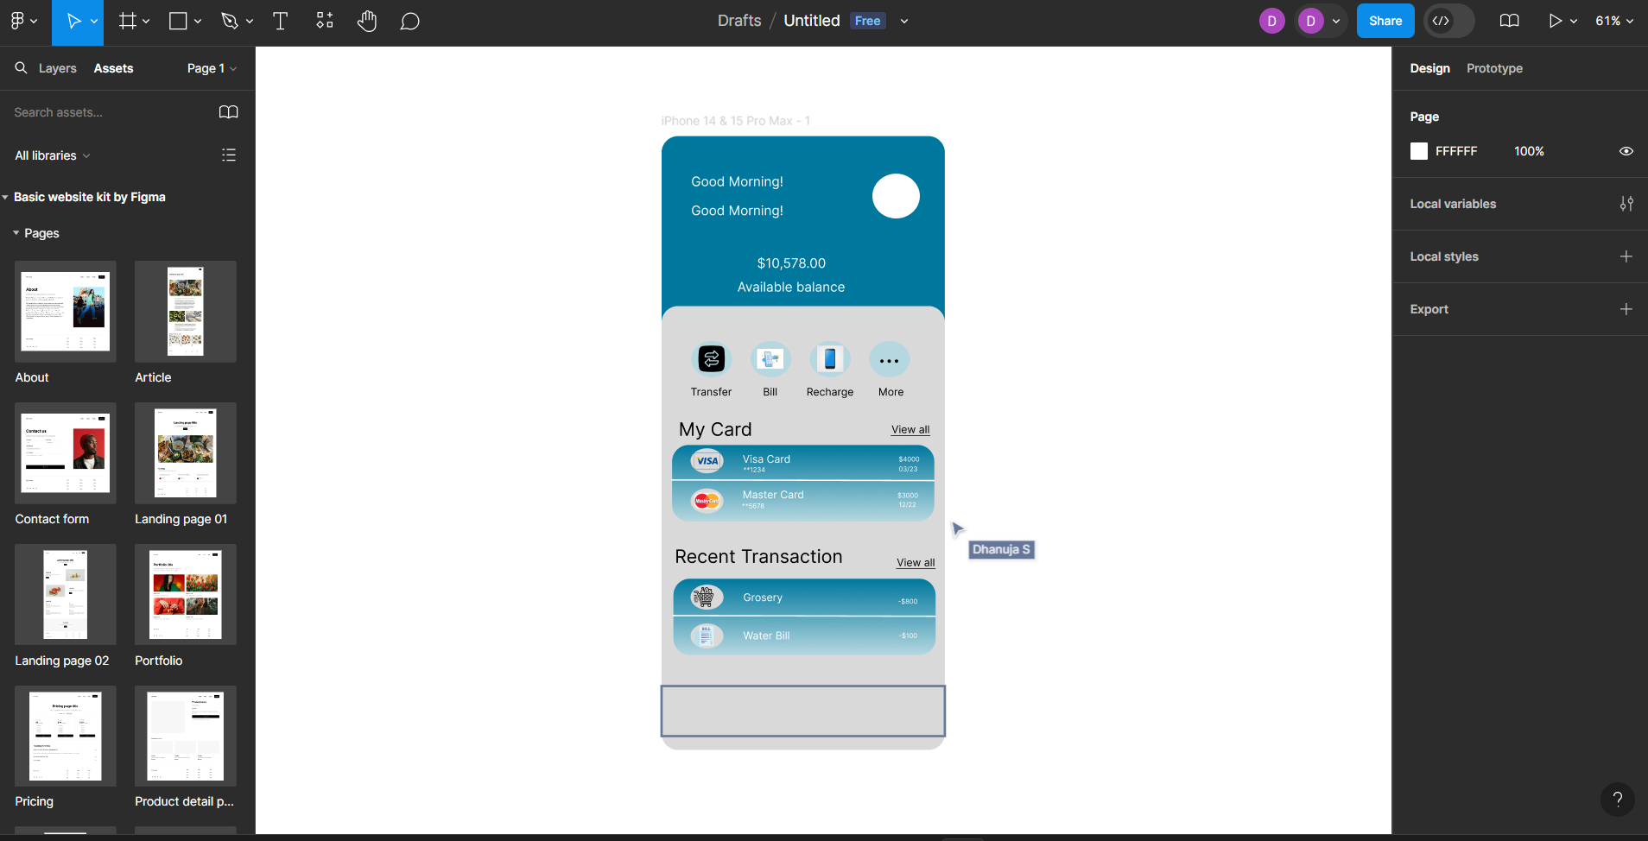
Design Process

Slide 10
Conclusion
By the end of Day 1,the project environment will be set up successfully.
Initial research will be conducted, a project plan will be created.

